Slide 1

Player loyalty points calculation and bonus Distribution

Slide 2
Objective
Calculate loyalty points
Identify top 50 loyal players
Allocate bonus money fairly
Provide actionable insights for stakeholders
Datasets Used
Gameplay Dataset: User Id, Games Played, Date& Time
Deposit Dataset: User Id, Deposit Amount
Withdrawal Dataset: User Id, Withdrawal Amount

Slide 3

Understanding the Data

Slide 4
Dataset Information
first you clean the data set use of drop ,fill function for better accuracy and rename the columns .
Then check the datatype of datetime and pick the Datetime colum so the obj type convert to the Pandas Datetime from extract the individually month ,date and time .
calculate loyalty point for given formula and create a loyalty point table take reference with gameplay data set because it have active members for better insights
in gameplay table take assumption formula of loyalty point column for required another tabel .

Slide 5
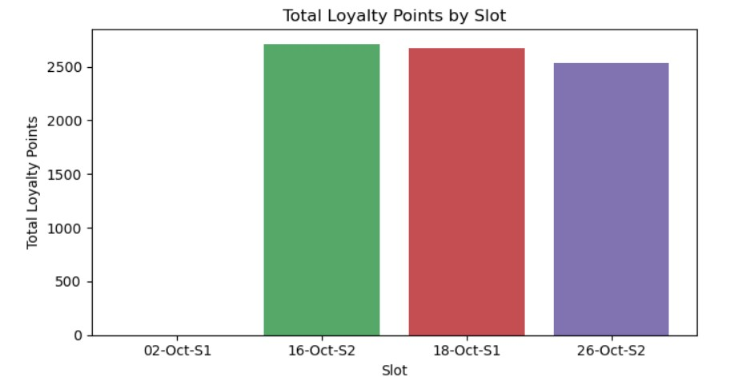
No Activity on 02-Oct-S1
The 02-Oct-S1 slot has no recorded loyalty points, indicating either zero customer transactions or possible data issues.
Peak Engagement on 16-Oct-S2
The highest loyalty points were recorded on 16-Oct-S2 (~2600), suggesting strong customer participation or effective promotions during this slot.

Slide 6
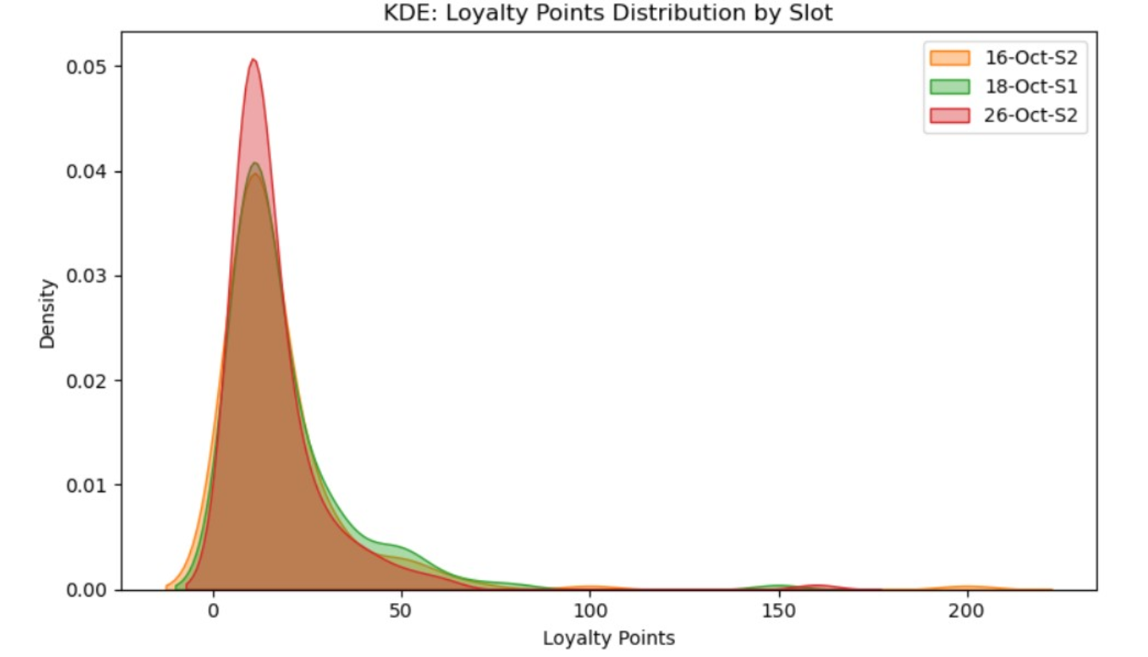
Majority Earn Low Points Most customers across all slots earned very low loyalty points (close to 0), showing low-value or small-ticket transactions are common.
High-Value Customers Exist There's a long right tail in all distributions — indicating a few customers earned over 100 points. These are potential high-value customers and should be prioritized for retention and premium offers.
Similar Customer Behavior Across SlotsThe shape of the distributions is consistent for all slots, suggesting customer spending patterns remained stable over time without major shifts.

Slide 7
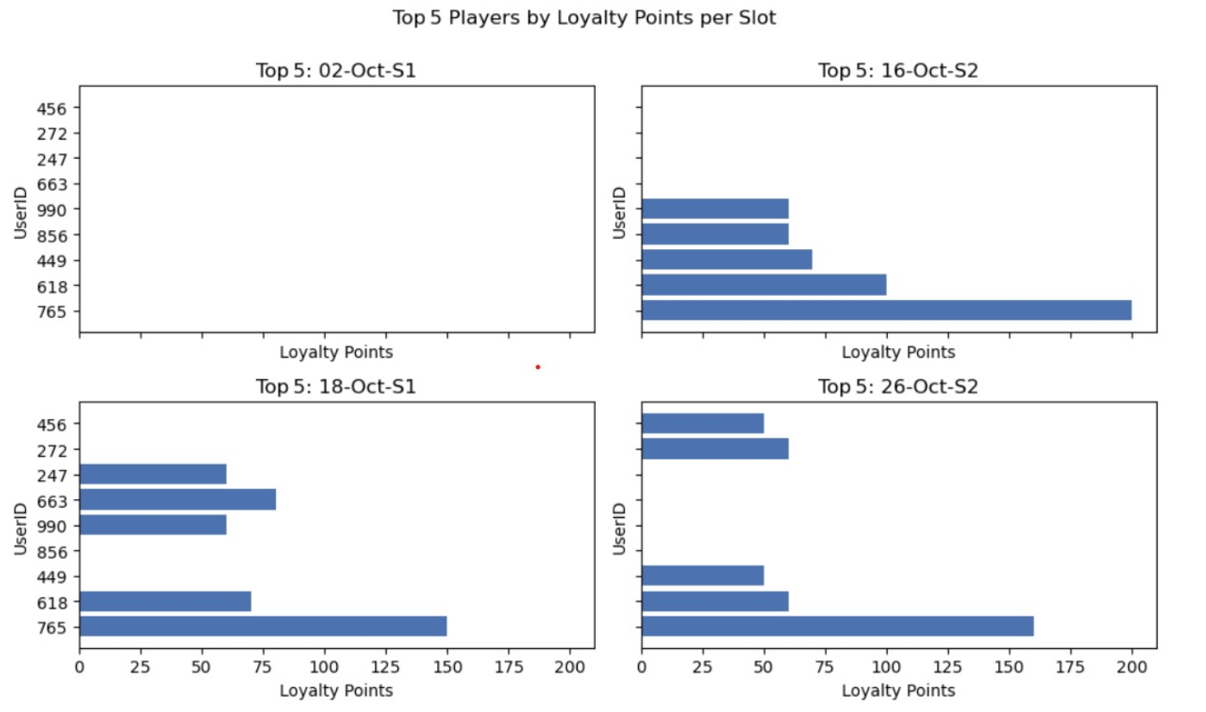
Few High-Contributing Customers Drive Loyalty Points In each slot, a small group of top 5 customers contribute a significant portion of total loyalty points.This indicates a strong dependency on loyal, high-spending customers.
16-Oct-S2 and 26-Oct-S2 Have Strong Top Performers The highest loyalty points (close to 200) are seen in these slots, highlighting peak customer activity.These top performers can be targeted for loyalty programs, special recognition, or exclusive offers.
02-Oct-S1 Shows Zero EngagementThe absence of top 5 data for 02-Oct-S1 again confirms zero customer activity or data collection issue in that slot.Immediate investigation or data pipeline check is recommended.

Slide 8
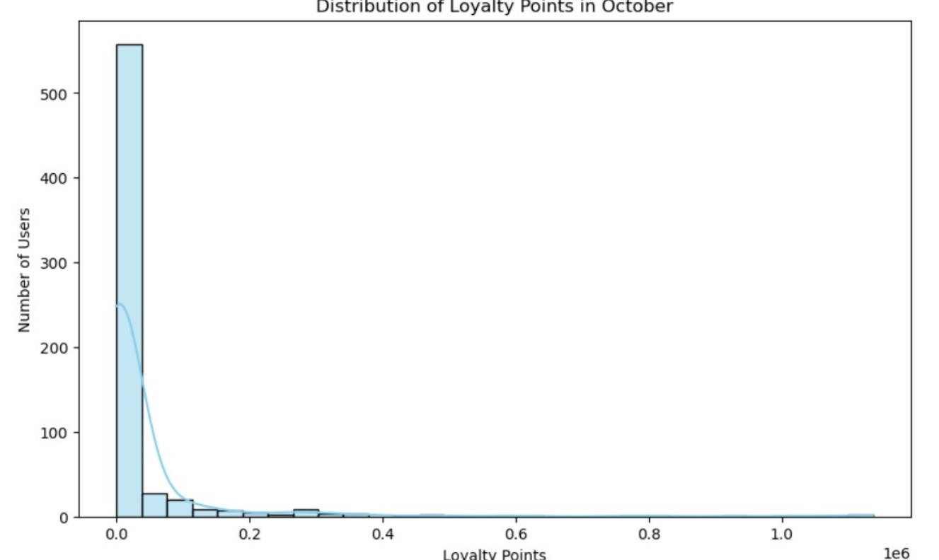
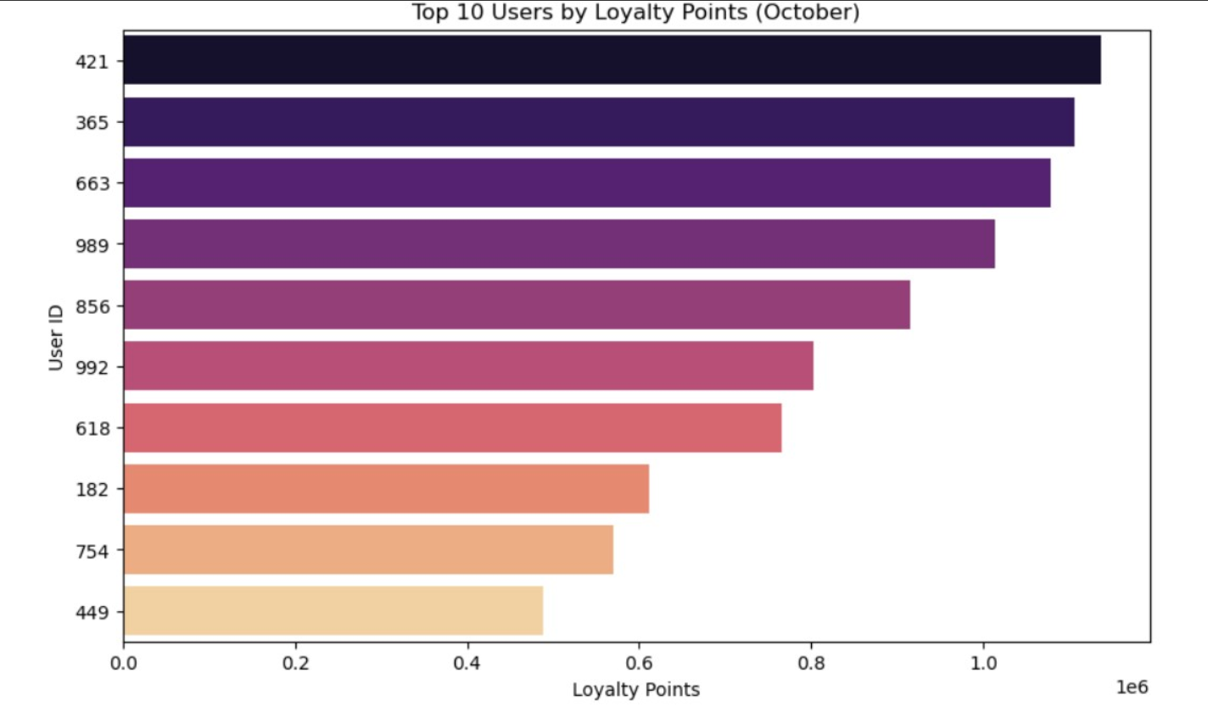
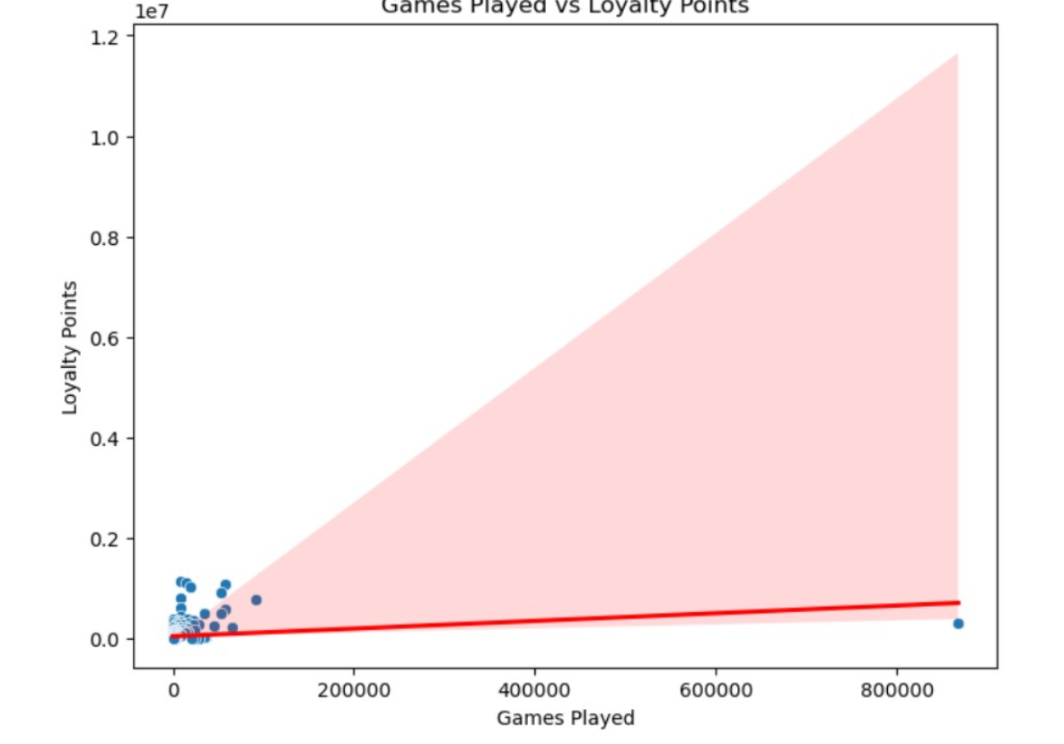
Majority of Users Earned Low Loyalty Points The distribution chart shows that a very large portion of users have earned very few loyalty points. The graph is heavily right-skewed, indicating that while most users have loyalty points closer to zero, only a few users managed to earn significantly higher points.
Top 10 Users Significantly Outperform Others The top 10 users have earned loyalty points in the range of approximately 0.2 to over 1 million points. This suggests that there is a very small but highly active user segment driving a major portion of total loyalty points, highlighting the presence of high-value or highly engaged users.
Positive Correlation Between Games Played and Loyalty Points The scatter plot between games played and loyalty points indicates a clear positive relationship: users who played more games tend to have earned higher loyalty points.

Slide 9
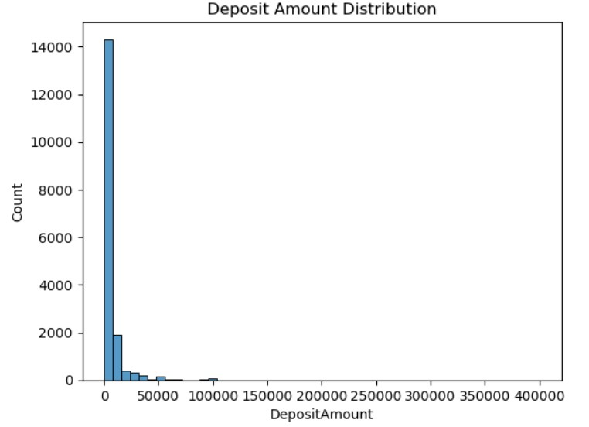
Deposit Amount Analysis Insight The deposit amount distribution is highly right-skewed, showing that most users deposited small amounts . The majority of users deposited amounts less than ₹5,000 to ₹10,000.Only a very small number of users deposited very large amounts (more than ₹50,000 or ₹100,000), which indicates a few high-value depositors contribute disproportionately to total deposit volumes.
This pattern is very similar to what we saw in the loyalty points — a small segment of highly engaged or high-spending users are contributing most of the revenue and loyalty points

Slide 10
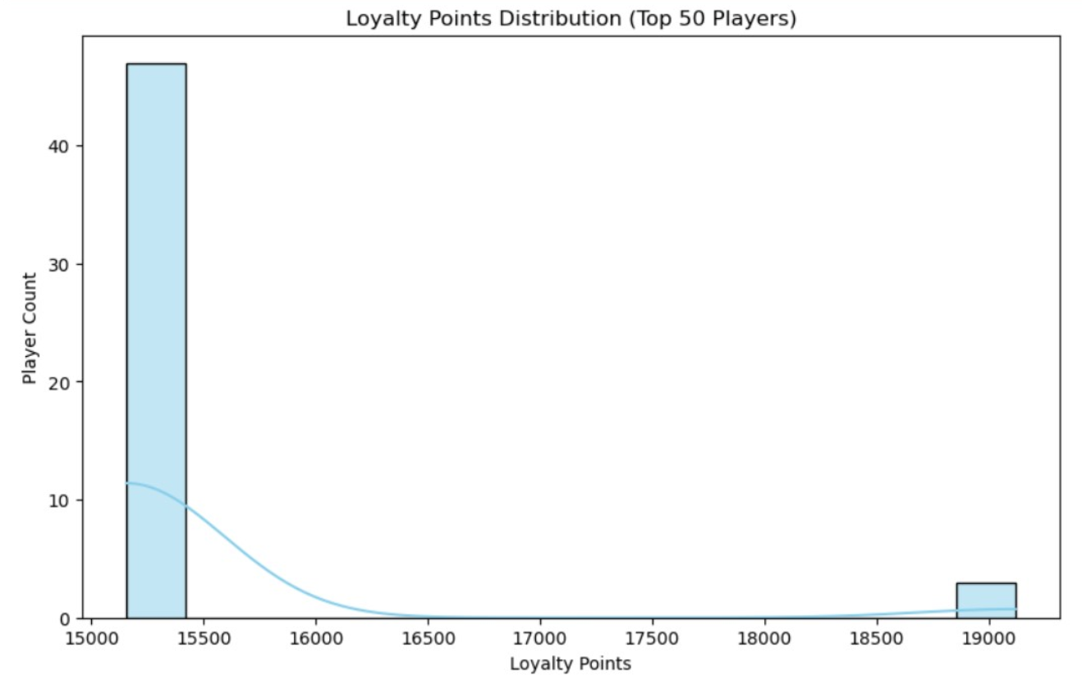
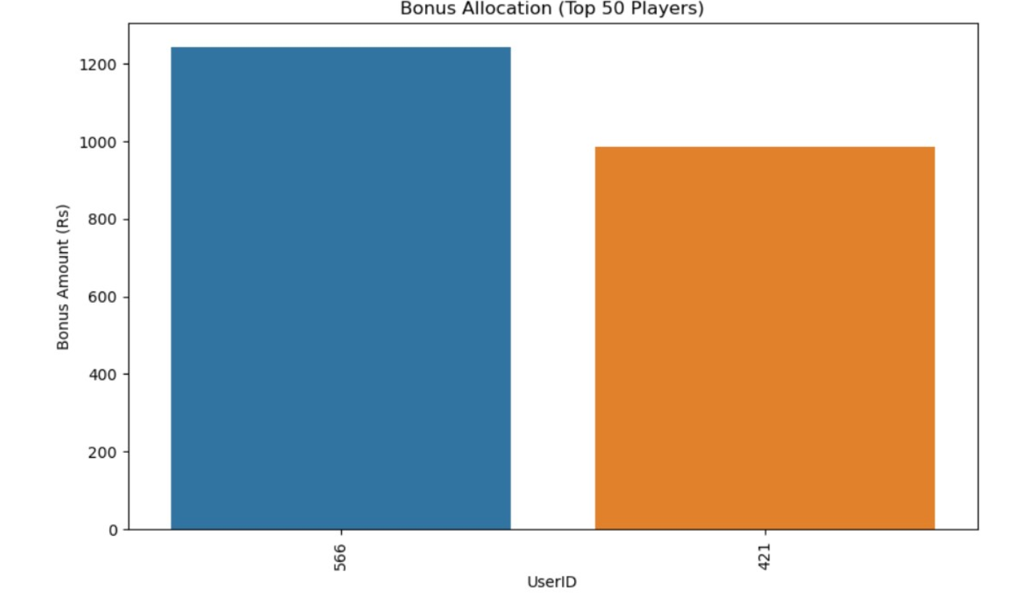
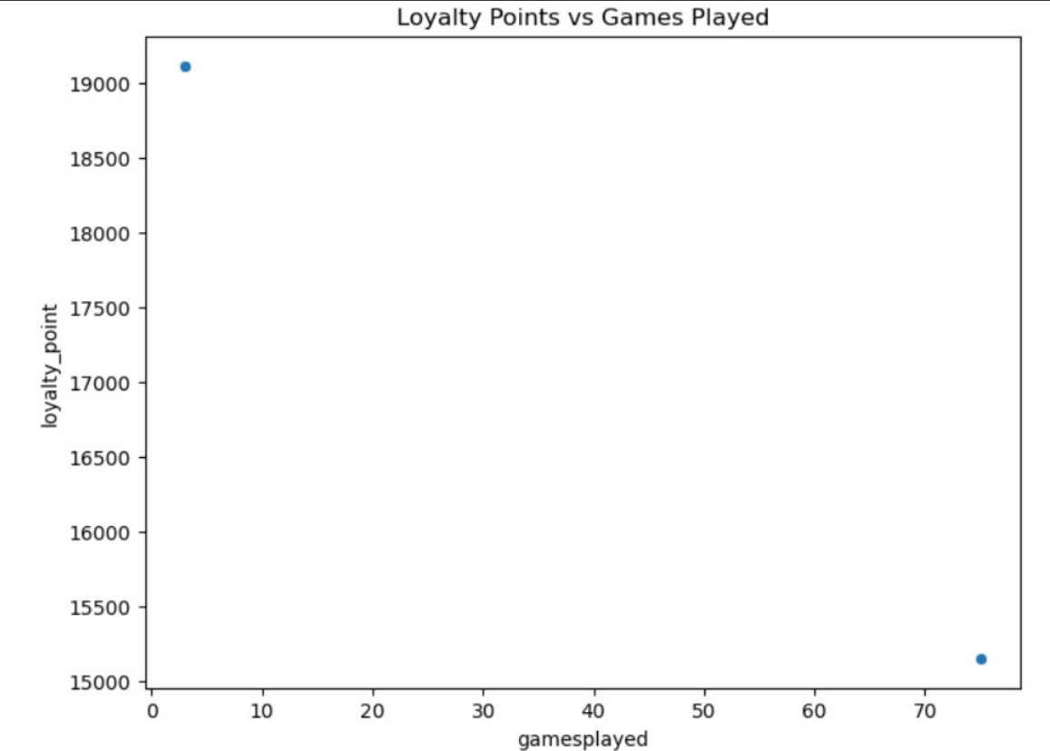
Heavy Skewness in Loyalty Points:Majority of the users earn very low loyalty points, while a very small group (top 1-2%) earn extremely high points. This suggests that a few highly engaged or high-value players dominate loyalty earnings.
Top Players Hold Significant Loyalty Points:The top 10 users alone hold a huge proportion of loyalty points pool, highlighting possible VIP or premium players who may deserve focused retention or bonus strategies.
Loyalty Points Not Only Dependent on Games Played:The scatter plot shows that playing more games does not always mean earning higher loyalty points. Business may have multiple earning criteria (e.g., higher stakes, bonus points, special events) impacting loyalty point accumulation.

Slide 11
Would you say the loyalty point formula is fair or unfair?
=>Yes, it is fair. Reasons:
Balances Revenue and Engagement : Loyalty points reflect spending.Games played reflect engagement and activity.
Rewards Diverse Player Behavior : High spenders and frequent players both get rewarded.
Can you suggest any way to make the loyalty point formula more robust?“
We can include active days to reward regular users, not just high spenders.We can also slightly cap very high loyalty points to avoid few users getting very large bonuses.
If possible, we can even add lifetime value or how long the user is active on platform, to reward true long-term loyal users.
And finally, we can adjust weights based on business goals: like acquisition or retention phase.

Slide 12
Conclusion
The loyalty point system fairly allocates rewards, supports both engagement and revenue , and promotes healthy platform growth .
With small improvements can become even more effective for long term business.
Anmol sahoo
7847872793
bitunanmolsahoo@gmail.com

